Slide 1
Lesson Three
Add Questions and Answers.
Dragos Rosca
Automatica si Calculatoare 2018

Slide 2
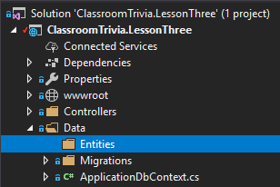
Adding Entities
In the folder data we will add a folder called Entities

Slide 3
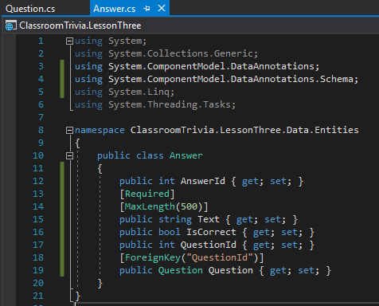
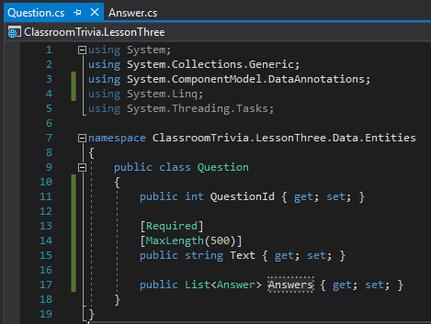
Adding Entities
In the Entities folder we will add our model classes.
Question
Answer

Slide 4
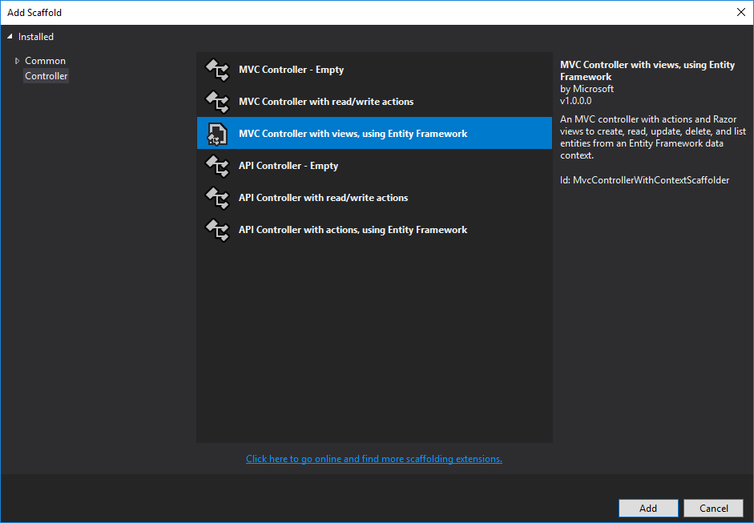
Adding Question Controller
On the Controller folder Add New Controller

Slide 5
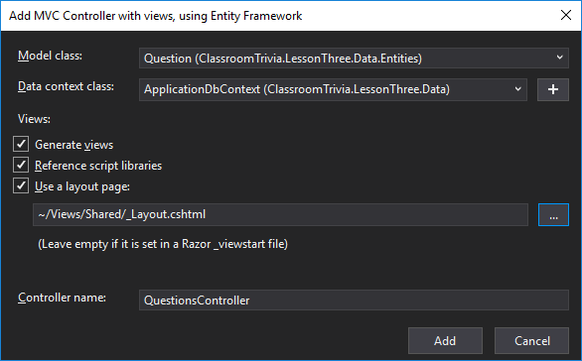
Adding Question Controller
Complete the fields for the QuestionsController

Slide 6
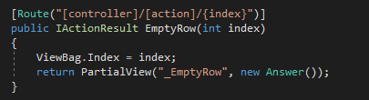
Adding Question Controller
In the QuestionsController add a new method to get an empty row for the answers list

Slide 7
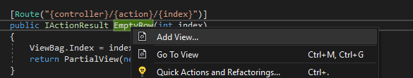
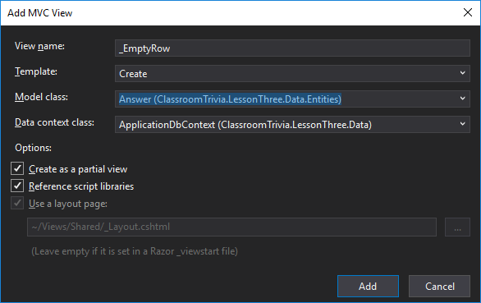
Adding Question Controller
On this method name right click and choose Add View…
On the Add View window fill in the fields
At this point you should be able to
Add-Migration

Slide 8

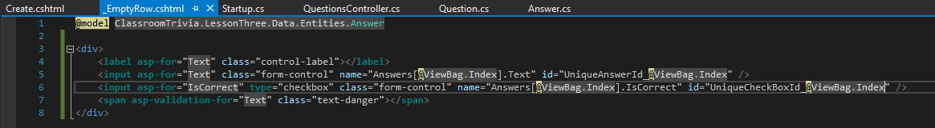
Adding Question Controller
In the new created partial view _EmptyRow delete everything except the first line
Fill in with the following code

Slide 9
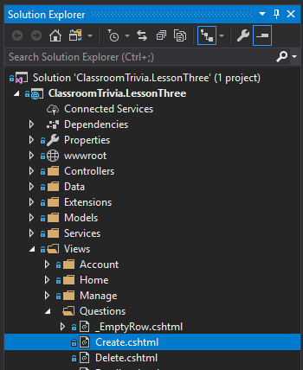
Adding Question Controller
Open the Create view from the Questions folder in the Views folder.

Slide 10
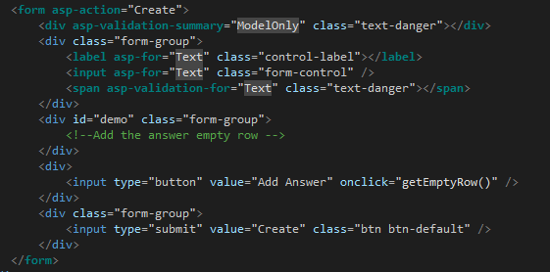
Adding Question Controller
Between the two form group div tags add a new div with the class form-group and the ID “demo”

Slide 11
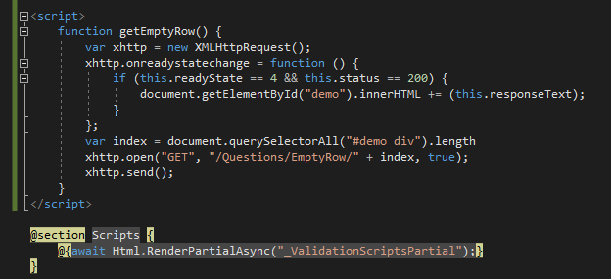
Adding Question Controller
At the end of the file add the script for AJAX call to get an empty row

Slide 12
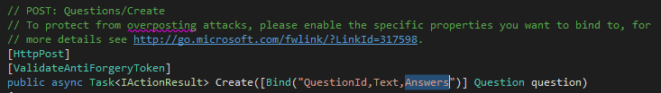
Adding Question Controller
In the questions controller class we will modify the Create endpoint to bind the Answers property

